Slide 1

Graduation Project 1 Presentation
“Designing a Traffic Anomaly Detection System using Deep Learning”

Slide 2
Author's
Name | ID
Waleed Abulkhair | 437029773
Abdulaziz Bin Laswad | 437030312
Abdulkarim Sahli | 437032635
Zyad Alfahmy | 439012290

Slide 3

Team Prosses Guidelines
Appendix A

Slide 4

I. Team Mission and Objective
objective: the objective of this project is to design, and prototype Designing a Traffic Anomaly Detection system using Deep learning, the system will detect anomaly activity using Deep Learning techniques to make an efficient way to get stricter in any road. The system will detect anyone who breaks the law on the road.
Team Mission:
Deep Learning: Zyad, Waleed, Abdulkarim and Abdulaziz.
Data Science: Zyad and Waleed
Python Programming: Waleed, Abdulkarim and Abdulaziz.
Embedded system: Zyad and Abdulkarim

Slide 5
II. Decision Making
Expert Member
Majority Control
Decision by Authority

Slide 6
a. Expert Member
The expert member who clearly know the exact problem, he can solve problems in his filed
If one of the members didn’t agree with his idea, then the majority decides

Slide 7
b. Majority Control
We ask for a vote and if 3 out of 4 members agreed, then the decision is decided
if the majority didn’t agree, then we move to the next step “Decision by Authority After Discussion”.

Slide 8
c. Decision by Authority After Discussion
If the majority didn’t agree a discussion will be held among the members
The leader will make the final Decision

Slide 9
III. Meeting Guidelines
Meeting Agenda & Summary
Meeting Rules
Meeting Time
Meeting place

Slide 10
a. Meeting Agenda Summary
Agenda: The agenda will be discussed in the summary of the previous meeting
Summary
The writer should write a summary of the meeting that include next week's agenda
The mediator should fill the Graduation Project Weekly Meetings Attendance Sheet (Form B) provided by the computer engineering department

Slide 11
b. Meeting Roles
All team members should attend the meeting.
Meetings can be in person or online.
The absent of a single time member will cancel the meeting.

Slide 12

c. Meeting Time
In person, it will be with Dr. Saleh Basalamah on Wednesday from 12:45 pm to 01:30 pm.
Microsoft Teams, we determine the appropriate time to meet each other online.

Slide 13
d. Meeting place
In Person:
With Dr. Saleh Basalamah: In the office of Dr. Saleh Basalamah
Without Dr. Saleh Basalamah a: In the Computer engineeringDepartment meeting room for students
Online:
Online using the feature of meeting on Microsoft Teams to edit Microsoft Office files online
Using ZOOM to meet Dr. Saleh Basalamah

Slide 14
IV. Team roles
Leader
Recorder
Spokesman
Optimist
Pessimist
Analyst

Slide 15

Leader
The leader is not necessarily the authority figure but should guide the team through the processes of decision making and problem solving. Effective leaders should ensure that all opinions are heard and that everyone is involved. Leaders coordinate tasks such as identifying the agenda.
Assigned to: Zyad Alfahmy

Slide 16


Recorder
Job description: The recorder is responsible for maintaining a record of the team's work, documenting important results, and recording responsibilities for different tasks using the Graduation Project Weekly Meetings Attendance Sheet (Form B) provided by the computer engineering department.
Assigned to Abdulaziz Bin Laswad.

Slide 17

Spokesman
Job description: The spokesman articulates the team's results. The recorder and spokesperson roles are sometimes combined
Assigned to Waleed Abulkhair

Slide 18
Optimist
Job description: The spokesman articulates the team's results. The recorder and spokesperson roles are sometimes combined
Assigned to Abdulkarim Sahli

Slide 19
Pessimist
Job description: The pessimist should challenge ideas and assumptions, and make sure that opposing ideas are presented and discussed.
Assigned to Abdulaziz Bin Laswad and Waleed Abulkhair.

Slide 20

Analyst
Job description: The team analyst performs the important role of observing the team processes and provides feedback to the team for improvement.
Assigned to Zyad ALfahmy

Slide 21
V. Conflict Resolution
Each member of the team should anonymously supply adscription of the conflict and suggested solution to the mediator Recorder
The mediator proposes a solution to the conflict which is fed back to the team.
The team members are given an opportunity to suggest modifications to the proposed resolution
Steps 1-3 are repeated until consensus is achieved

Slide 22
VI. self-assessment checklist for team formation and processes
Team formation | Score
The team's objectives are clearly defined. | 4
There is consensus among all team members that the objectives are the correct ones. | 4
The team members complementary skills (technical, functional, interpersonal have been identified. | 3
There are enough members on the team to cover all the necessary competencies. | 3
There are not too many members on the team. | 5
Team processes | Score
The team has developed clear guidelines for resolving conflicts and disagreements. | 5
the team has developed effective guidelines for holding all members of the team manually accountable for achieving the objectives | 4
The team has developed a strategy for holding effective meetings | 5
The team has agreed upon a mutual meeting time and place | 4
The team members trust each other. | 4
The team members demonstrate respect for each other's ideas | 4

Slide 23

Project Selection
Appendix B

Slide 24
1. Selection criteria and Determine the project
What is a Selection criterion: The Selection criteria main selection criteria are the skills, attributes, and qualifications that the project or work assignees define, and they all must be fulfilled.
Why Selection criteria is important for the project: The project must be chosen correctly because appropriate selection leads to the effective success of the project. A smooth, simple and direct methods must be followed to measure the project-related processes and their consequences

Slide 25





The following considerations must be taken in choosing the project methodology:
The strategic and organizational goals and the basic values of the project.
Main business engines.
Restrictions that the project can face.
The risks involved in implementing the project.
The size and cost of the project.

Slide 26
Our Criteria for selecting the project
A) The project is based on the courses.
B) The project selected should not have been done in past years in the.
C) The project matches the team skills.
D) The project is achievable with in two semesters.
E) The project uses deep learning techniques.
F) The project uses Hardware.

Slide 27
Our Project Ideas
A
Designing a Smart surveillance camera system using deep learning.
B
Designing a traffic anomaly detection system using deep learning.
C
Designing a smart trash can system.
D
Designing an Arabic handwriting recognition system.

Slide 28
Select Project Idea
 | Criteria weights | Smart surveillance | traffic anomaly detection | Smart Trash | Arabic handwriting recognition
A | 0.15 | 0.30 | 0.56 | 0.06 | 0.08
B | 0.05 | 0.20 | 0.67 | 0.08 | 0.06
C | 0.24 | 0.24 | 0.64 | 0.06 | 0.06
D | 0.33 | 0.54 | 0.31 | 0.09 | 0.05
E | 0.15 | 0.14 | 0.67 | 0.05 | 0.15
F | 0.07 | 0.20 | 0.15 | 0.61 | 0.4
SCORE |  | 0.33 | 0.49 | 0.11 | 0.07
After doing the Analytic hierarchy process for each criteria with the project the result will be in the final table

Slide 29
Determine the needs for the project selected
Marketing requirements
Objective tree
ranking need using pairwise comparison
Objective tree with ranking

Slide 30
Marketing requirements
The system should be Easy to Use.
Long Operating Time
Multiple Data Formats
Limited Controls
Easy to install
The system should Sustain Environmental Conditions.
Water Resistant
Drop Resistant
Outdoor Temperatures
Functionality
The system should be able to detect traffic anomalies
During Day time
During Nighttime
The system should have High Quality Image.
Low Distortion
Long Distance
The system should be work on real time
The system should have high accuracy.
The system should be working all time.

Slide 31
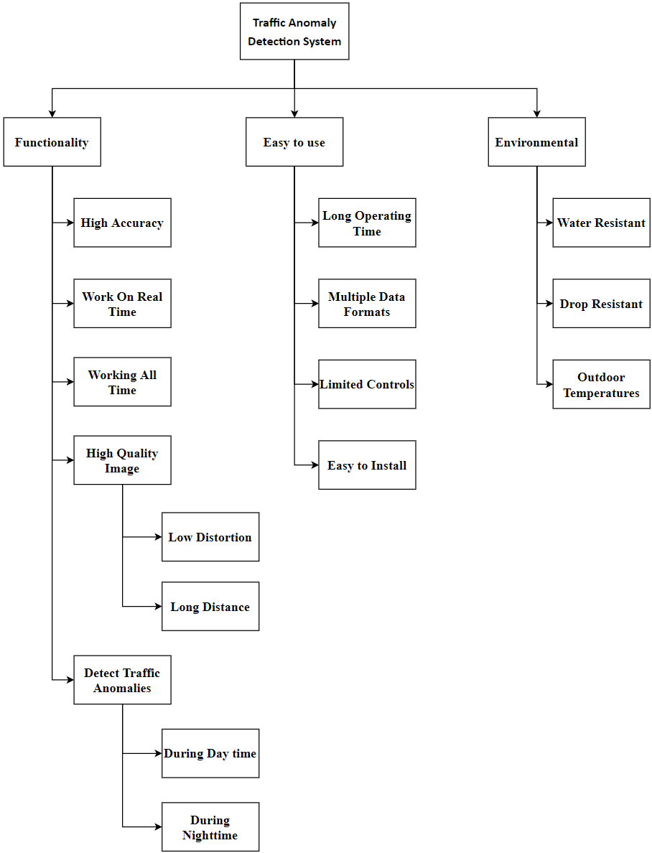
Objective tree

Slide 32
ranking need using pairwise comparison
 | Functionality | Easy to use | Environmental | geometric mean | weights
Functionality | 1 | 5 | 3 | 2.47 | 0.62
Easy to use | 1/5 | 1 | 1/5 | 0.34 | 0.09
Environmental | 1/3 | 5 | 1 | 1.19 | 0.30
Table 9: AHP for traffic anomaly detection system using deep learning

Slide 33
ranking need using pairwise comparison
AHP for traffic anomaly detection system using deep learning
AHP for Environmental
 | Functionality | Easy to use | Environmental | geometric mean | weights
Functionality | 1 | 5 | 3 | 2.47 | 0.62
Easy to use | 1/5 | 1 | 1/5 | 0.34 | 0.09
Environmental | 1/3 | 5 | 1 | 1.19 | 0.30
 | Water Resistant | Drop Resistant | Outdoor Temperatures | geometric mean | weights
Water Resistant | 1 | 5 | 1 | 1.71 | 0.48
Drop Resistant | 1/5 | 1 | 1/3 | 0.41 | 0.11
Outdoor Temperatures | 1 | 3 | 1 | 1.44 | 0.41

Slide 34
ranking need using pairwise comparison
AHP for Easy To Use
AHP for Functionality
 | Long Operating Time | Multiple Data Formats | Limited Controls | Easy to Install | geometric mean | weights
Long Operating Time | 1 | 3 | 3 | 5 | 2.59 | 0.50
Multiple Data Formats | 1/3 | 1 | 5 | 3 | 1.50 | 0.29
Limited Controls | 1/3 | 1/5 | 1 | 1/3 | 0.39 | 0.08
Easy to Install | 1/5 | 1/3 | 3 | 1 | 0.67 | 0.13
 | detect traffic anomalies | High Quality Image | work on real time | have high accuracy | working all time | geometric mean | weights
detect traffic anomalies | 1 | 5 | 3 | 1 | 3 | 2.14 | 0.37
High Quality Image | 1/5 | 1 | 1/3 | 3 | 7 | 1.07 | 0.20
work on real time | 1/3 | 3 | 1 | 1/5 | 5 | 1.00 | 0.17
have high accuracy | 1 | 1/3 | 5 | 1 | 1 | 1.11 | 0.19
working all time | 1/3 | 1/7 | 1/5 | 1 | 1 | 0.39 | 0.07

Slide 35
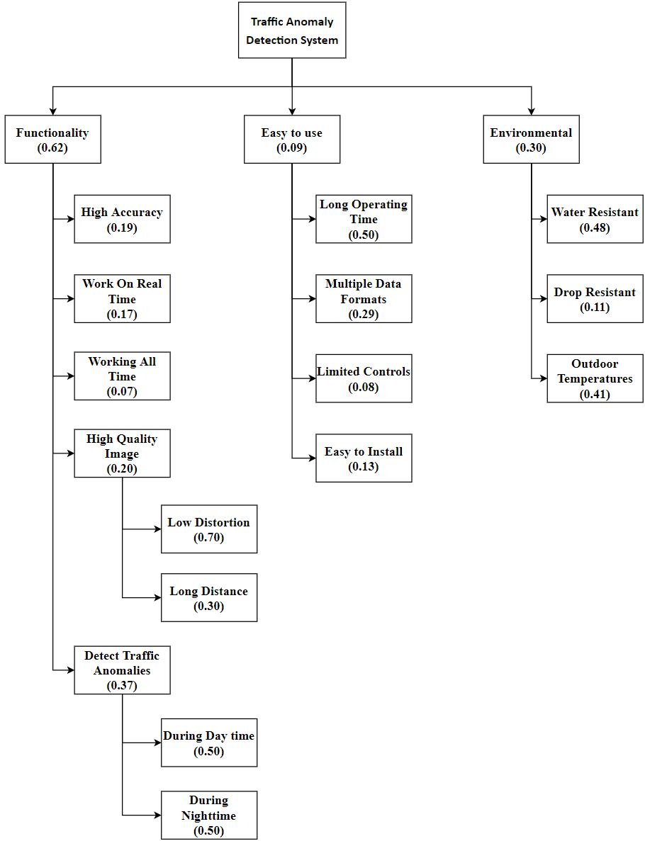
Objective tree with ranking

Slide 36
Project Planning
Appendix C

Slide 37
1. Introduction
1.1.What is Project planning?
1.2.Why Project planning is important?
1.3.How Project planning is done?

Slide 38

1.1.What is Project planning?
Project planning is complete the project stages at a specific time for each stage in specific and divided stages and specific costs and resources that have been identified before by the team.

Slide 39

1.2.Why Project planning is important?
Project planning plays an important role in helping guide stakeholders, sponsors, teams, and the project manager through other project stages. Planning is needed to identify desired goals, reduce risks, avoid missed deadlines, and delay deliver the agreed product, service or result. Without planning, project performance will be barely fine.

Slide 40

1.3.How Project planning is done?
project planning will be done using the Time Management and cost management, the Time Management will consist of Work Brake structure, Network Diagram, and Grant Chart. While the Cost Management will consist of estimation of possible costs.

Slide 41
2. Time Management
What is Time Management
Why Time Management is Important
How Time Management is Done

Slide 42
2.1.What is Time Management
Project management are decisions taken by the team to organize and distribute the project time at all stages of the project so that it facilitates work on the team and increases the efficiency of time management and reduces the tension associated with the project.

Slide 43

2.2.Why Time Management is Important
Time management is important because it helps you to control your workday so you can build your business without influence badly on your work-life balance, there are benefits of time management, improve your performance, increase production, deliver work on time, reduce your stress and boost your confidence.

Slide 44
2.3.How Time Management is Done
Time management will be done using the Work Breakdown Structure, Network Diagram and Grant Chart work breakdown structure (WBS) is a hierarchical breakdown of the tasks and deliverables. A network diagram is a directed graph representation of the tasks and dependencies between them in the project. Grant Chart is a graphical representation of tasks on a timeline.

Slide 45
2.2. Work Breakdown Structure
2.2.1.1 What is Work Breakdown structure?
2.2.1.2 Why Work Breakdown Structure is important?
2.2.1.3 How Work Breakdown Structure is done?

Slide 46
2.2.1.1 What is Work Breakdown structure?
It is an analysis that is a hierarchical form whose main objective is to hand over the work assigned to the project team and achieve the project goals and complete the agreed outputs and is also the basis for each action plan to ensure the effectiveness and efficiency of the project and the project implementation and monitoring and reporting on any changes in the project and all the required tasks are identified and evaluated and its budget determined. The work distribution structure has been developed to achieve a common understanding of the project.

Slide 47

2.2.1.2 Why Work Breakdown Structure is important?
The main purpose of a WBS is to reduce complicated activities to make tasks easy. This is important for the project manager because he can understand the tasks more effectively than complex activities. Tasks must be measurable and independent, with clearly defined limits.

Slide 48

2.2.1.3 How Work Breakdown Structure is done?
To do a Work Breakdown structure a Table needs to be created the includes an Activity with its ID and Checkpoints and duration time and people and resources and the predecessor for each activity.

Slide 49
2.2.2.Work Breakdown Structure for the Project
ID | Activity | Decomposition | Deliverables | Duration (days) | People | Resources | Predecessor
1 | Architecture Design
1.1 | Neural Network Design | Complete detailed design And Verify |  | 30 Days | WD, ZY | PC/Jupiter
1.2 | Design Helping Functions | Complete Detailed Design Functions That Implement Data |  | 10 Days | AZ, ZY | LABTOP/ PyCharm | 1.1
1.3 | Purchase Components |  | Identify Needed Software/ Order / Receive Parts | 15 Days | AK | Amazon/ google

Slide 50
2 | Coding
2.1 | Build Neural Network | Complete code of 1.1 |  | 20 Days | WD, ZY | PC/Jupiter /Colab | 1.1, 1.3
2.2 | Build Helping Functions | Complete code of 1.2 |  | 10 Days | WD, AZ | LABTOP/ PyCharm | 1.2
2.3 | Combining the Code | Combine a Code of 2.1 and 2.2 | Fully Working Software | 5 Days | AK, ZY | PC/Jupiter /Colab /LABTOP/ PyCharm | 2.2, 2.1
3 | Training the model
3.1 | Implementing Dataset | Import Data set Into Code |  | 5 Days | AK, WD | LABTOP/ Computer/D ataset | 2.3
3.2 | Training on The Dataset | Run the training | Detecting Anomaly | 42 Days | ZY, AZ | GPU/ Colab | 3.1
4 | Testing
4.1 | Checking the Whole Code |  |  | 10 Days | AZ, AK | research paper/ GitHub | 3.1
4.2 | Debugging | Check That if Model Run Without any Problems |  | 10 Days | ZY, WD |  | 3.1

Slide 51
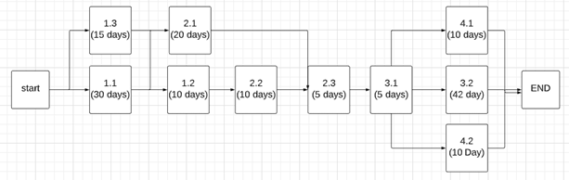
2.3.2. Network Diagram for the Project
So, as we can see in this diagram is not like any series, for example, we can do 1.2, 1.3 and 2.1 if we complete 1.1, another critical one is 3.1, if we complete it, we can do 3.2, 4.1, 4.2 to the end.

Slide 52
There are many paths for this project
P1 = {1.1, 1.2, 2.2, 2.3, 3.1, 3.2}, this the first path with total 102 days.
P2 = {1.1, 1.2, 2.2, 2.3, 3.1, 4.1}, this the second path with total 70 days.
P3 = {1.1, 1.2, 2.2, 2.3, 3.1, 4.2}, this the third path with total 70 days.
P4 = {1.1, 2.1, 2.3, 3.1, 3.2}, this the fourth path with total 102 days.
P5 = {1.1, 2.1, 2.3, 3.1, 4.1}, this the fifth path with total 70 days.
P6 = {1.1, 2.1, 2.3, 3.1, 4.2}, this the sixth path with total 70 days.
P7 = {1.3, 2.1, 2.3, 3.1, 3.2}, this the seventh path with total 87 days.
P8 = {1.3, 2.1, 2.3, 3.1, 4.1}, this the eighth path with total 55 days.
P9 = {1.3, 2.1, 2.3, 3.1, 4.2}, this the ninth path with total 55 days.

Slide 53

2.3.2. Network Diagram for the Project
2.3.2.1. Critical Path: So, we have here two critical paths, P1 and P4 with total 102 days.
Time of critical paths = 102 days
2.3.2.2. Float: All activities in P1 and P4 are included except 1.2 and 2.2 in P4, in other hand 2.1 in P1, so the float is P1 – P4 which means that 102 – 102 days = 0 days, at the end it’s zero float, Using the same process, we can calculate the float for other paths as well.
Float for the second, third, fifth, and sixth paths = 102 – 70 = 32 days.
Float for the seventh path = 102 – 87 = 15 days.
Float for the eighth and ninth paths = 102 – 55 = 47 days.
2.3.2.3. Slippage: Actually, we have two critical paths activities 1.3, 2.1, 4.1 and 4.2 in P1 have the collective slippage is:
Slippage for P1 = 102 – 55 days = 47 days
While the activities 1.2, 2.2, 4.1 and 4.2 in P4 have the collective slippage is:
Slippage for P4 = 102 – 55 days = 47 days

Slide 54
2.4. Gantt Chart
Introduction
Gantt Chart for the Project

Slide 55
2.4.1. Introduction
What is Gantt Chart?
Why Gantt Chart is Important?
How Gantt Chart is Done?

Slide 56

2.4.1.1. What is Gantt Chart
It is a scheme commonly used in organizing and managing projects and it is widely spread among companies because it is useful and wonderful for showing the latest and timeline and tasks and it consists of a list of tasks and activities and consists of a second part of the time scale and each task represents a tape and we can see three things in the task bar the date it started and the date of its completion and the time of the task It was designed by American engineer Henry Gantt.

Slide 57
2.4.1.2. Why Gantt Chart is Important
Gantt chart is useful for planning and scheduling projects. They help you specify how long a project should take, determine the resources needed, and order in which you'll complete tasks. They're also helpful for managing the dependencies between tasks.

Slide 58

2.4.1.3. How Gantt Chart is Done
To do a Gantt chart first select a software then chooses the data then create the chart by inserting the data and its dependencies.

Slide 59
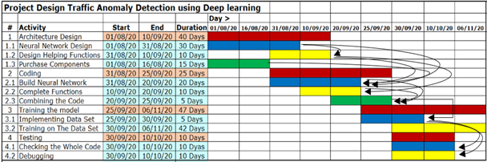
2.4.2. Gantt Chart for the Project

Slide 60
2.4.3 Tasks that included in Gantt Chart
In the Gantt Chart for the project there are four main tasks:
1-Architecture Design starts from 08/01/2020 and ends on 10/10/2020.
2- Coding starts on 08/20/2020 and ends on 9/25/2020.
3- Training the model It starts on 09/20/2020 and ends on 6/11/2020.
4- Testing begins on 09/30/2020 and ends on 10/10/2020.
The colors were distinguished in the date column in light orange and the sub-tasks listed under the main tasks of light color and in the path columns of the plan The main task in red is four tasks and the sub-tasks gradually color it so that the first sub-task is a blue balloon and the second is in yellow and the third sub task is in the green We have a total of four main tasks and ten sub-tasks.

Slide 61
3. Cost Management
3.1. Introduction
3.2.Cost Estimation for the Project
3.3.Break-Even Analysis

Slide 62
3.1. Introduction
What is Cost Management
Why Cost Management is Important
How Cost Management is Done

Slide 63

3.1.1.What is Cost Management
Cost management is a method of saving expenses spent on operating the project and producing products in order to reduce the cost and provide products at a reasonable price and great quality to consumers. The main goal is to save costs and manage money in the best possible way to achieve the highest possible profit.

Slide 64

3.1.2. Why Cost Management is Important
Cost management is important for all project participants. It sets the basis for what the project is expected to cost and takes measures to ensure that the project is budgeted. Without cost management, companies will lose money or customers will receive invoices more than expected in worst cases.

Slide 65

3.1.3.How Cost Management is Done
In order to do the cost management there are two things that are needed to be considered firstly Labor cost and secondly Equipment cost then the Break-Even Analysis need to be calculated using the formula.

Slide 66
3.2. Cost Estimation for the Project
1. Fixed Cost
2. Variable Cost
3. Break-Even Analysis

Slide 67
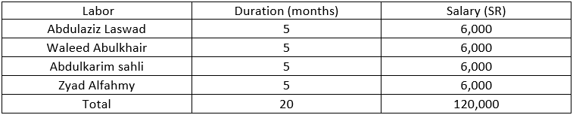
1. Fixed Cost
Fix Cost consists of Manpower Budget cost, Equipment Needed cost and Miscellaneous cost so to sum up: Fixed Cost = Manpower Budget + Equipment Needed + Miscellaneous Cost.
i. Manpower Budget:
Manpower Budget is the salary that all members receive it for doing the project.
Table 2: Manpower Budget
In table 2 Abdulaziz Laswad he is good in Neural Network, Waleed Abulkhair he is responsible on create classes and functions in Python, Abdulkarim Sahli he is good in Hardware, Zyad Alfahmy he is responsible to combine all the work and make sure every member in the team is working well.

Slide 68
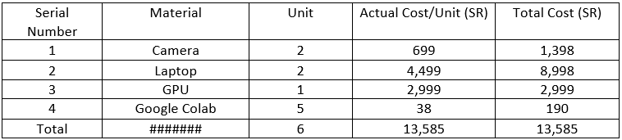
1. Fixed Cost
ii. Equipment Needed:
The Equipment Needed are the equipment that the project needs it, every item multiplied by the unit.
Table 3: Equipment Needed
In table 3 we need a Camera to detect traffic anomaly, and for the Laptop we will use it to create classes and functions in Python, and we need the GPU for Neural Network, and Google Colab allows us to write and execute Python in the web browser, with zero configuration required, free access to GPUs, easy sharing

Slide 69
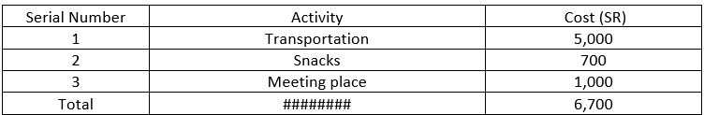
1. Fixed Cost
iii. Miscellaneous Cost:
The extra cost that are not manpower or equipment, it be can anything.
Table 4: Miscellaneous cost
In order to do some tasks of the project we need to spend some money on Transportation fees, Snacks and Meeting places shown in Table 4. Transportation cost more because some tasks requires traveling from Makkah to Jeddah, we need to eat snacks in order to get energy, the manpower need energy to work on the project

Slide 70
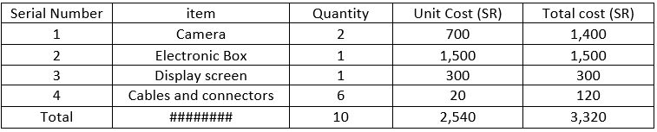
2. Variable Cost
A variable cost is a project expense that changes in proportion to production output.
Table 5: Variable Cost
To create the final product the items which are in Table 5 is needed. Each Electronic Box is only capable of possessing the output from two cameras. Therefore, the maximum limit selected is two cameras and a single display screen with their cables.

Slide 71

3.3 Break-Even Analysis
Break-Even Analysis is the point at which cost, and revenue are equal, there is no net gain or loss and one has a “DRAW”.
Fixed Cost= Manpower Budget + Equipment Needed + Miscellaneous Cost = 120,000 + 13,585 + 6,700 = 140,285, Variable Cost = 3,320, Total Cost = fixed cost + n * variable cost / unit = 140,285 + 100 * 3,320 / 5 = 206,685 SR, Revenue =n*sale price / unit = 100 * 10,334.25 / 5 = 206,685 SR, Profit = total revenue - total costs = 206,685 – 206,685 = 0 SR.
So, in order to fulfil the Break-Even Analysis when n = 100, the unit should be 5 and the sales price should be 10,334.25 SR so that total revenue - total costs = 0.

Slide 72
Designing a Traffic Anomaly Detection System using Deep Learning
Main Report

Slide 73
1. Research Problem
/
1.1. Need Statement
1.2. Objective
1.3. Background and Related work
1.4. Objective Tree

Slide 74
1.1. Need Statement
Thousands of traffic crashes occur every day [19]. Detecting traffic anomalies will help in reducing the number of accidents. As according to [20] Speed cameras were efficient at reducing the number of accidents, and speed cameras are nothing but a primitive anomaly detection system that is only able to detect speed. Therefore, implementing an anomaly detection system using deep learning will reduce car accidents in a direct and indirect way. Firstly, it will be able to detect traffic violation such as wrong turns, wrong driving direction, lane change errors and all other anomalies. Secondly, it will be able to detect natural disasters on the road such flooding, rockslide and Sand encroachment then inform the authorities about them.

Slide 75
1.2. Objective
The aim of this project is to design a Traffic Anomaly Detection system using Deep learning. That detects Traffic Anomaly including wrong turns, wrong driving direction, lane change errors and all other anomalies, by absorbing information that based on video feed from a camera.

Slide 76
1.3. Background and Related work
1.3.1. Neural network: An artificial neural network is a very essential part of the project that via an algorithm allows the computer to learn by incorporating new data. Neural networks can perform what has been termed deep learning. The essential building block of an artificial neural network is a perceptron which accomplishes simple signal processing, and these are then connected into a large mesh network.
Thus it’s a technique that is cable of achieving the detection of anomalies.

Slide 77
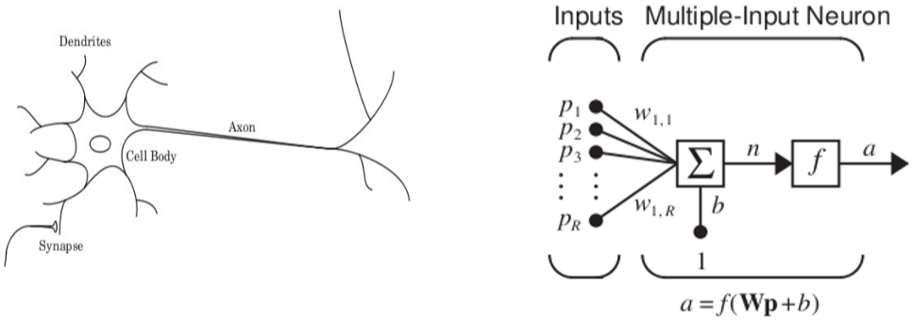
Neural network
- The biological neuron and the mathematical neuron

Slide 78
Neural network
Biological Neuron Component | Biological Function | Mathematical Model
Dendrites | The dendrites are tree-like receptive networks of nerve fibers that carry electrical signals into the cell body. | Input variables p's
Cell Body | The cell body effectively sums and thresholds these incoming signals. | f(Wp+b)
Axon | The axon is a single long fiber that carries the signal from the cell body out to other neurons. | Output variable a
Synapse | It is the arrangement of neurons and the strengths of the individual synapses, determined by a complex chemical process, that establishes the function of the neural network. | Weight variables w's

Slide 79









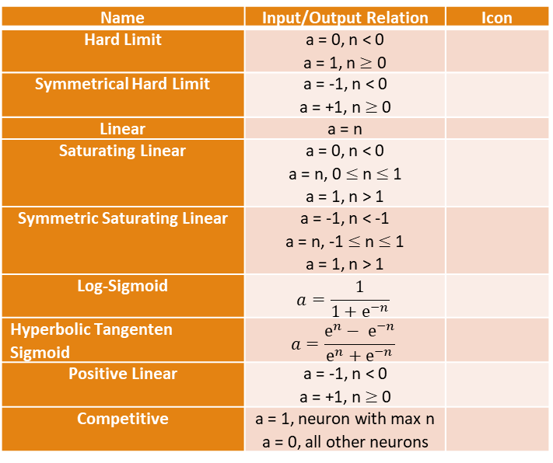
Activation function of Neural Network
Name | Input/Output Relation | Icon
Hard Limit | a = 0, n < 0 a = 1, n$≥$ 0
Symmetrical Hard Limit | a = -1, n < 0 a = +1, n$≥$ 0
Linear | a = n
Saturating Linear | a = 0, n < 0 a = n, 0 $≤$ n$≤$ 1 a = 1, n > 1
Symmetric Saturating Linear | a = -1, n < -1 a = n, -1 $≤$ n$≤$ 1 a = 1, n > 1
Log-Sigmoid | $$a=\frac{1}{1+ⅇ^{−n}}$$
Hyperbolic Tangenten Sigmoid | $$a=\frac{ⅇ^{n}− ⅇ^{−n}}{ⅇ^{n}+ⅇ^{−n}}$$
Positive Linear | a = -1, n < 0 a = +1, n$≥$ 0
Competitive | a = 1, neuron with max n a = 0, all other neurons

Slide 80
1.3.2. Related work
Unsupervised anomaly detection
Object detector

Slide 81
Unsupervised anomaly detection
The unsupervised anomaly detection can be only trained by using a normal dataset [1].
Some methods assumes that the features of anomalous events cannot be learned from the data of normal events [14].
While others [2][4][8] learns the features of normal events through deep neural networks and automatic encoders.
Convolutional LSTMs Autoencoder (ConvLSTM-AE) to model the normal pattern on [2][7].
Using a background modeling and object detection methods to extract anomalous events on [12][13]. Which is the best solution

Slide 82
Object detector
There are a single stage detector and a two-stage detector
The two-stage detector first generate a set of region proposals and then refine them by CNN networks[3].
the proposals are extracted in advance by the selective search algorithm [10], then each proposal is more accurately corrected by the convolutional network.
Faster-RCNN [9] proposes the RPN layer, extracts the possible proposals on the feature map by selecting appropriate anchors.
MaskRCNN [5] proposes ROI Align method instead of ROI pooling to further improve the accuracy of regression.
FPN [6] proposes a pyramid connection structure from top to bottom. Compared with the image pyramid used by SSD [11],

Slide 83
1.4. Objective Tree

Slide 84
2. Requirements Specification
Marketing Requirement
Engineering Requirement

Slide 85
2. Requirements Specification
Marketing Requirement
Engineering Requirement
Constrains

Slide 86
Marketing Requirement
The system should be Easy to Use.
The system should Sustain Environmental Conditions.
Water Resistant
Drop Resistant
Outdoor Temperatures
Functionality of the System
The system should be able to detect traffic anomalies
During Day time
During Nighttime
The system should have High Quality Image.
Low Distortion
Long Distance
The system should be work on real time
The system should have high accuracy.
The system should be working all time.
Long Operating Time
Multiple Data Formats
Limited Controls
Easy to install

Slide 87
Engineering Requirement
Marketing Requirements | Engineering Requirement | Justification
A, C | The system has long battery with more than 12 hr. | This provide the system to work all time if electricity is down
C | The system will detect anomaly with percentage of 50% | This provide the system to have best performance to processing the data without consummating much power
A | The system will be with limited options | People always love the easy way, and this will provide the attract of the system
B | The system will work in any natural condition | This provide the system to be more flexible.
A, C | The system will be able to work from long distance maximum 2 km | This provide the system to work from anywhere, anyplace, any hight.
A: The system should be Easy to Use
B: The system should Sustain Environmental Conditions
C: Functionality of the system

Slide 88
Constrains
2.2.1. Economic
The cost for developing the system should not exceed (3000) SAR.
2.2.2. Legal
We communicated with the company that has a data set in detect anomalies, and they give us the data set that we need it for our project.
2.2.3. Environmental
The system will be work on any situation, on the daytime and nighttime, it has waterproof to work in rain, and have good material to resist high temperatures.
2.2.4. Political
We will cooperate with the government to share some of the information captured by the system in order to automatically monitor the violation of the anomaly.
2.2.5. Operational
The system should be able to operate in the temperature range of -5℃ to 60℃.
2.2.6. Reliability and Availability
The system must be accredited by the government because it detects violations and does not like there to be any possibility of error.
2.2.7. Energy
The system will have an average power assumption of (200) mW.
2.2.8. Performance
The system should detect (more than 60%) of all traffic anomalies.
2.2.9. Functionality
When the system detects traffic anomalies, it will immediately record a violation of the anomaly.

Slide 89
The END
Thank you for listening

